Slide 1

Escherichia coli
Mamita Rai Gurung

Slide 2
General characteristics
They are gram negative rods.
They belong to the family enterobacteriaceae
They are non spore forming and non capsulated
They are facultative anaerobes or aerobes.
They are lactose fermenters and are indole positive.
Most of them are motile with peritrichous flagella (except E blattae)
They are normal flora of stomach.

Slide 3
When normal host defences are inadequate particularly in infancy or old age, in terminal stages of other diseases, after immunosuppression or with indwelling venous or urethral catheters, the bacteria may reach the blood stream and cause sepsis.
The most frequent site of clinically important infection are urinary tract, biliary tract and other sites in abdominal cavity.

Slide 4
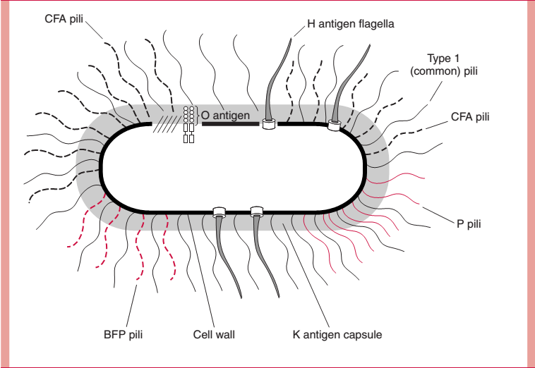
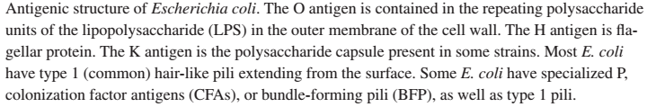
Antigenic structure
Somatic antigen (o antigen)
Surface antigen (K antigen)
Flagellar antigen (H antigen)
Fimbrial antigen (F antigen)

Slide 5
Somatic antigen (O antigen)
They are the cell wall lipopolysaccharide and consists of repeating units of polysaccharides.
There are about 150 O antigens.
Specific O antigens of E coli are found in diarrhoea and UTI.
Antibodies to 0 antigens are Predominantly of IgM type.
Surface antigen (K antigen)
They are capsular polysaccharide antigen.
K antigens may interfere with agglutination by O antisera.
K antigens are associated with virulence factor.
Divided into 2 groups (I and II)
There are about 9 K antigens.
Notes:
D by

Slide 6
Flagellar antigen (H antigen)
They are flagellar antigen and more than 50 H antigens have been identified.
They may interfere with agglutination by anti-O antibody.
Fimbrial antigen (F antigen)
Pili (fimbriae) are frequently present on the surface of E. coli
More specialized pili are found in subpopulations of E. coli.
P pili(also called Pap or Gal– Gal) bind to digalactoside (Gal– Gal) moieties present on certain mammalian cells, including uroepithelial cells and erythrocytes of the P blood group.
Those binding to human enterocytes are called colonization factor antigens(CFAs) or bundle-forming pili(BFP),depending on the pathogenic type of E. coli involved and possibly the cell type in the gastrointestinal tract.

Slide 7
Toxins
The α-hemolysin is a pore-forming cytotoxin that inserts into the plasma membrane of a wide range of host cells in a manner similar to streptolysin O and Staphylococcus aureus α-toxin. The toxin causes leakage of cytoplasmic
contents and eventually cell death.
Enterotoxin: Some strains of E coli produces enterotoxins that cause GI disorders. Eg: ETEC produces either one or two entero toxins-heat stable (ST) and heat labile (LT) enterotoxin.

Slide 8
Pathogenesis & clinical manifestation
Extra-Intestinal disease
1. Urinary tract infection
2. Neonatal meningitis and sepsis
Nosocomial wound infection(hospital acquired infection)
  Intestinal disease
  1. Enteropathogenic E. coli (EPEC) –neonatal/infants diarrhea
  2. Enterotoxigenic E. coli (ETEC) - travelers’ diarrhea
  3. Enteroinvasive E. coli (EIEC) - bloody mucoid diarrhea
  Enterohermorrhagive E. coli (EHEC) - hemorrhagic colitis and HUS, caused by E. coli 0157:H7
  Enteroaggregative E. coli (EAEC) - acute and chronic diarrhea
  Diffusely adherent E. coli (DAEC) - diarrhea in children

Slide 9
Urinary tract infection
E. coli is the commonest pathogen isolated from patients with cystitis. Recurring infections are common in women.
Infection of the bladder is called cystitis and infection of the kidney is called pyelonephritis whereas infection of the anterior urinary tract is called urethritis.
The reservoir for these infections is the patient’s own intestinal E. coli, which contaminate the perineal and urethral area
Relatively minor trauma or the mechanical effect of sexual intercourse have been shown to allow bacteria access to the bladder.
Factors that violate bladder integrity (urinary catheters) or that obstruct urine outflow (enlarged prostate) are also associated with infection.
The ability of uropathic E. coli to produce UTI is related to general virulence factors such as α -hemolysin, together with pili-mediated adherence to uroepithelial cells.
Sign and symptoms: dysuria, urinary frequency, hematuria and pyuria.

Slide 10
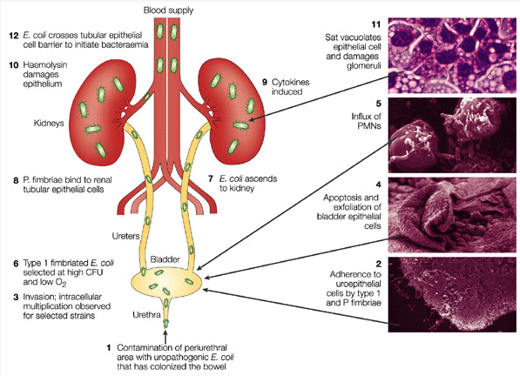

Slide 11
Neonatal Meningitis
E. coli is one of the most common causes of neonatal meningitis, many features of which are similar to group B streptococcal disease.
The pathogenesis involves vaginal E. coli colonization of the infant via ruptured amniotic membranes or during childbirth. Failure of protective maternal immunoglobulin M (IgM) antibodies to cross the placenta and the special susceptibility of newborns surely plays a role.
Approximately 75% of E coli from meningitis cases have K1 antigen whose mechanism is unclear.

Slide 12
Septicaemia
When normal host defense are inadequate, E coli may reach blood stream and cause septicaemia.
Newborns may be highly susceptible as they lack IgM antibodies.

Slide 13
ETEC
ETEC is recognized as the causative agent of travelers' diarrhea and illness is characterized by watery diarrhea with little or no fever.
Occurs most frequently among those travelling from areas of good hygiene to lower standards warmer countries.
ETEC infections occurs commonly in under-developed countries .
Sources of spread in warm climate countries is due to contaminated water by human and sewage .

Slide 14
Pathogenesis
due to the production of LT and ST. Besides it also possess colonization factors that enable the organism to adhere to the epithelium of the small intestine.
There are several variants of ST, of which ST1a or STp is found in E. coli isolated from both humans and animals, while ST1b or STh is predominant in human isolates only.
The infective dose of ETEC for adults has been estimated to be at least 10⁸ cells; but the young, the elderly and the infirm may be susceptible to lower levels.
Production of LT can be detected by Y-1 adrenal cell assays or serologically by commercial reverse passive latex agglutination assay and ELISA. The production of ST can also be detected by ELISA or by infant mouse assay.
Both LT and ST genes have also been sequenced by PCR and gene probe assays are available. Analysis of colonies on plating media using gene probe/colony hybridization also allows enumeration of ETEC in foods.
Biken test

Slide 15
heat labile (LT) enterotoxin.
- Mol wt (86kDa) and plasmid encoded.
- resembles cholera toxin
Composed of one enzymatically active polypeptide A subunit and 5 identical B subunit.
B subunit attach to ganglioside (G protein) at brush border of epithelial cells of small intestine and fascilates entry of subunit A into the cell.
Subunit A activates adenyl cyclase and increases local concentration of cAMP which results in intense and prolonged hypersecretion of water and chloride and inhibits reabsorption of sodium in small intestine.
The net effect is the accumulation of water and electrolyte into the bowel lumen.
heat stable (ST) enterotoxin.
Low mol weight (4kDa)and poorly immunogenic polypeptide.
2 types- STA and STB
ST binds to glycoprotein receptor and activates membrane bound guanylate cyclase.
This leads to increase in cyclic GMP and causes LT like net secretion of fluid and electrolyte into the bowel lumen.

Slide 16
EIEC
EIEC closely resemble Shigella and causes an invasive, dysenteric form of diarrhea in humans.
Although the infective dose of Shigella is low and in the range of 10 to few hundred cells, volunteer feeding studies showed that at least 10⁶ EIEC organisms are required to cause illness in healthy adults.
Unlike typical E. coli, EIEC are non-motile, do not decarboxylate lysine and do not ferment lactose, so they are anaerogenic.
Infection is generally due to food-borne but cross infections may occur.
The most common serogroup is 0124.

Slide 17
Pathogenecity
primarily due its ability to invade and destroy colonic tissue.
After attachment to the epithelial cells, they induce the cells to take them up by endocytosis into endocytic vacuole into the cell which then lyse.
After vacuole lysis, the bacteria multiply within the epithelial cells and kill it.
They then spread to neighbouring cells and cause tissue destruction and consequent inflammation (symptoms of bacillary dysentry)
The invasion phenotype, encoded by a high molecular weight plasmid, can be detected by invasion assays using HeLa or Hep-2 tissue culture cells or by PCR and probes specific for invasion genes.

Slide 18
EPEC
EPEC causes a profuse watery diarrheal disease and it is a leading cause of infantile diarrhea in developing countries.
Through volunteer feeding studies the infectious dose of EPEC in healthy adults has been estimated to be 10⁶ organisms.
Pathogenesis of EPEC involves protein (encoded by eae gene) that causes attachment and effacing lesions; but it also involves a plasmid-encoded protein referred to as EPEC adherence factor (EAF) that enables localized adherence of bacteria to intestinal cells.
Production of EAF can be demonstrated in Hep-2 cells and the presence of eae gene can be tested by PCR assays .

Slide 19
EHEC or VTEC
EHEC are recognized as the primary cause of hemorrhagic colitis (HC) or bloody diarrhea, which can progress to the potentially fatal hemolytic uremic syndrome (HUS).
HC=characterised by grossly bloody diarrhoea usually in absence of pyrexia.
HUS= characterised by acute renal failure , etc. E coli 0157 is associated with typical HUS.
EHEC are responsible for the production of verotoxin or Shiga toxins (Stx).
The infectious dose for O157:H7 is estimated to be 10 - 100 cells; but no information is available for other EHEC serotypes. EHEC infections are mostly food or water borne

Slide 20
Pathogenesis
EHEC or VTEC produces 2 toxins VT1 and VT2.
They are similar to toxins produced by S.dysenteriae type 1 so VT toxins are a.k.a. SLT(Shigella like toxin) toxins.
Diagnosis
EHEC O157:H7 are phenotypically distinct from E. coli in that they exhibit slow or no fermentation of sorbitol and do not have glucuronidase activity
Gene probes and PCR assays specific for stx1 and stx2 and other trait EHEC markers are also available.
Agglutination by 0157 antiserum.
Testing for cytotoxic effect on vero cells

Slide 21
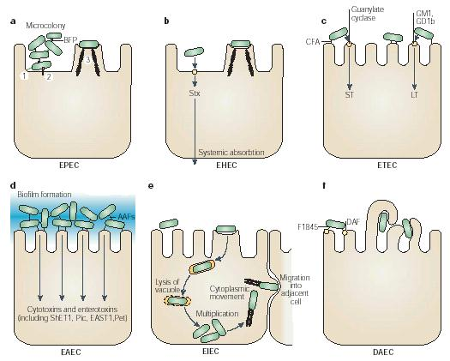

Slide 22
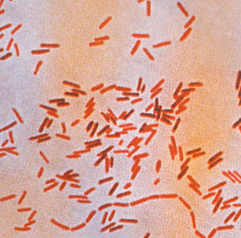
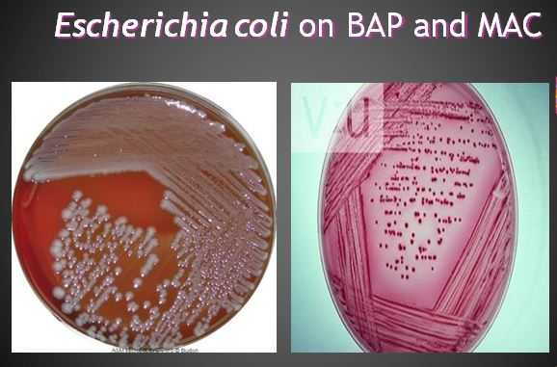
Lab diagnosis
Specimen
Depends upon the site of infection urine, pus, blood), particularly feaces for the dirrahogenic E coli
Microscopy
- Gram negative rods, motile, few are non motile and capsulated.

Slide 23
Culture
E coli is aerobe and facultative anaerobe.
In BA, mucoid greyish white colony may be observed and some strains are hemolytic.
In MA, they produce LF colonies due to lactose utilization.(Pink colonies)
In XLD, yellow colonies are seen.
In Sorbitol MacConkey agar: E. coli (VTEC) 0157 is non-sorbitol fermenting, producing colourless colonies whereas other E. coli strains and other enterobacteria ferment sorbitol.
Culture on EMB(Eosin Methylene blue) will show lactose fermenting colonies (dark blue with green sheen)

Slide 24
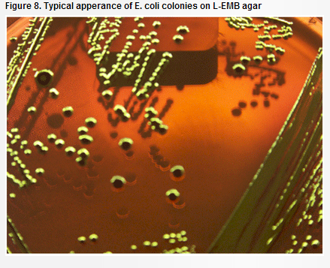
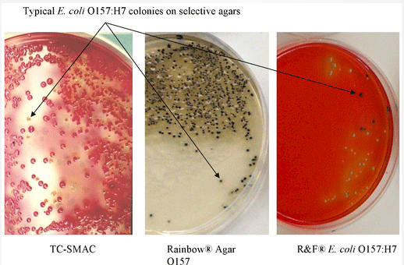

Slide 25
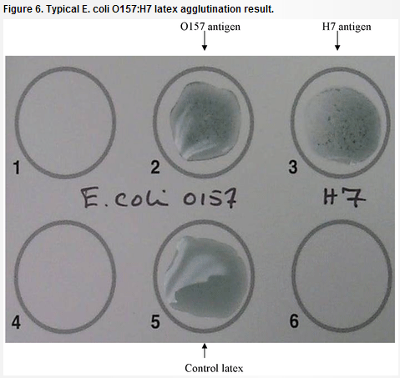
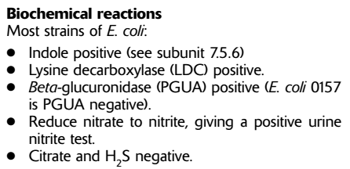
Serology
E. coli (VTEC) 0157 can be identified by testing the colonies using 0157 latex reagent.
To identify serotypes (O,H & K)
Biochemical tests

Slide 26
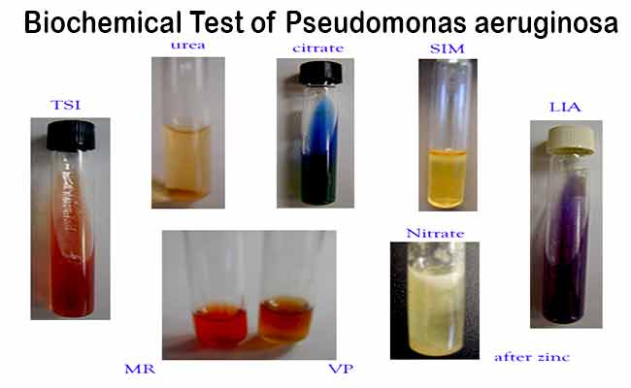

Slide 27
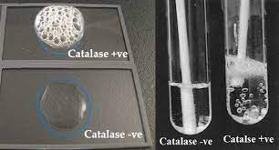
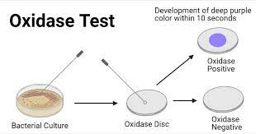

Slide 28
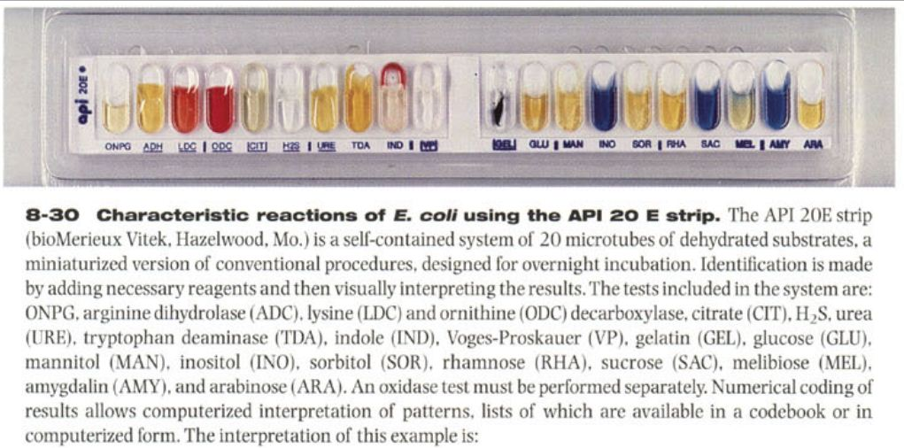

Slide 29
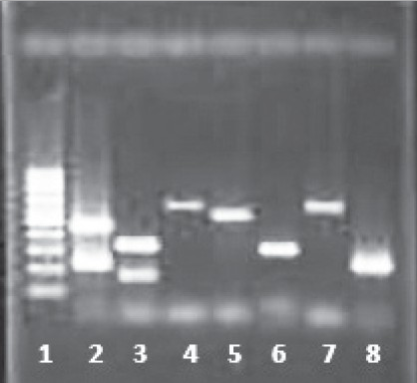
Multiplex PCR of reference strains and clinical samples.
Lane 1: DNA molecular size marker (100bp ladder)
Lane 2: Typical EPEC (eaeA amplicon size 229 and bfpA amplicon size 450)
Lane 3: ETEC (elt amplicon size 322 and Stla amplicon size 170
Lane 4: EAEC (CVD432 amplicon size 630bp)
Lane 5: EHEC (hlyA amplicon size 534bp)
Lane 6: EIEC (ial amplicon size 320)
Lane 7 and 8: clinical isolates of EAEC (CVD432) and atypical EPEC (eae)

Slide 30
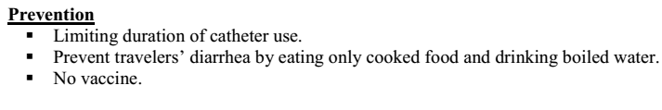
Antimicrobial susceptibility
Antimicrobials that are used to treat E. coli urinary and other infections include those with activity against Gram negative organisms such as; sulphonamides, trimethoprim, cotrimoxazole, nalidixic acid, nitrofurantoin, tetracycline, ampicillin,amoxycillin, cephalosporins, and aminoglycosides.
Plasmid-mediated antibiotic resistance, however, is common.
In the treatment of E. coli diarrhoea, the use of antibiotics is in general only of minor importance. Rehydration of the patient is always the most important measure taken

